Slide 1
Digital marketing project Phase 2
Team ID: LTVIP2023TMID10384
Team Leader :: Kottapalli Nandi
Kundangi eswari
Nakka meghana
Makka jayachandrika
Kuppa padma

Slide 2
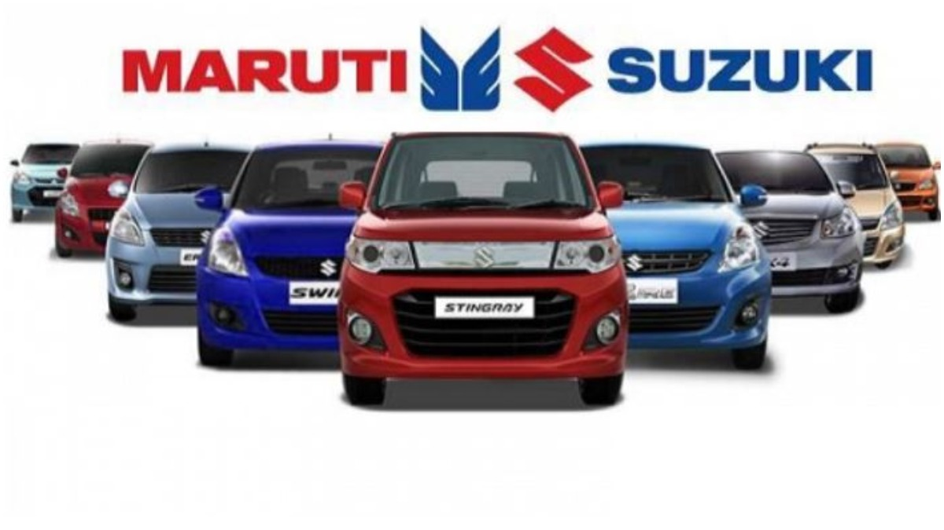
Maruti Suzuki

Slide 3
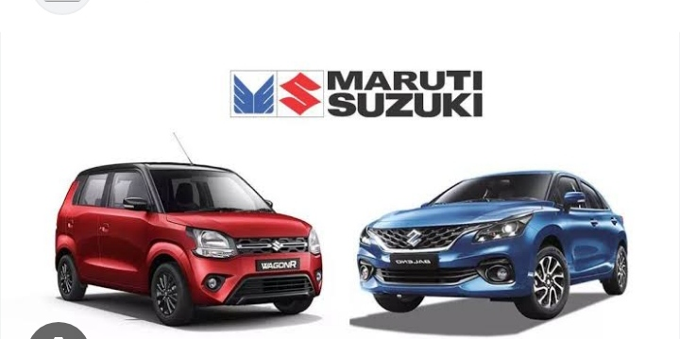
About our Project
Company / Topic for project : Maruti suzuki
Research Brand identity:
Brand logo :

Slide 4
Brand colours : Red and blue
Brand tagline : ‘way of life ‘
Brand website : https //www.Maruti Suzuki.Com

Slide 5

Brand study ,competitor Analysis & Buyer’s / Audience persona
Research Brand: Maruti Suzuki India Limited of Suzuki Motor Corporation, Japan, is India’s largest passenger car maker. Maruti Suzuki is credited with having ushered in the automobile revolution in the country. One of most important brand in the India.
Mission / Values : creating customer delight and shareholder wealth”, it is also distinctive being “a pride of India”. Increase their reasonable price and customer can buy reasonable price in the market.
USP : Unique selling proposition (USP) Maruti has car models in every segment with a wide price range to choose from, apart from being the most reliable name in Indian automobile market.
Analyze Brand Tone and identify: Maruti Suzuki as a brand products are the best.
Set 5 SMART goals and Kips for the Same : kpis are not same as goals .metrics should not become target.

Slide 6
Buyer’s persona
Buyers are looking for a vechicle fir Transportation with these important segment.
High cost
A joyful journey
More mileage
Good quality and strong body parts.

Slide 7
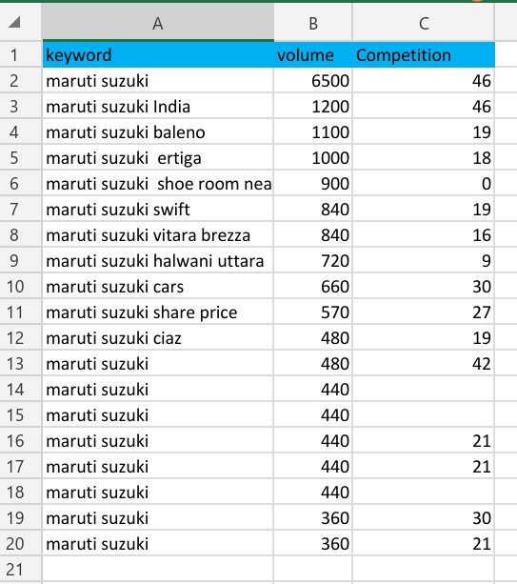
Part 2: SEO & Keyword Research
SEO & Keyword Research :
Site Analysis
Link building
Maintaing SERP Ranking
Keyword Research :
To increase website traffic:
as keyword research help us known Which Keywords are used by target customer mostly ,by we can improve our website traffic.

Slide 8
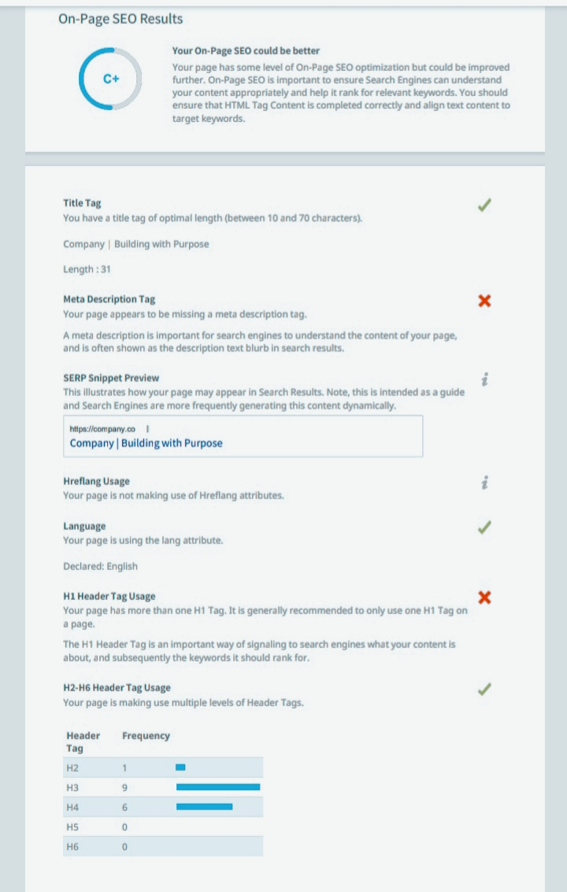
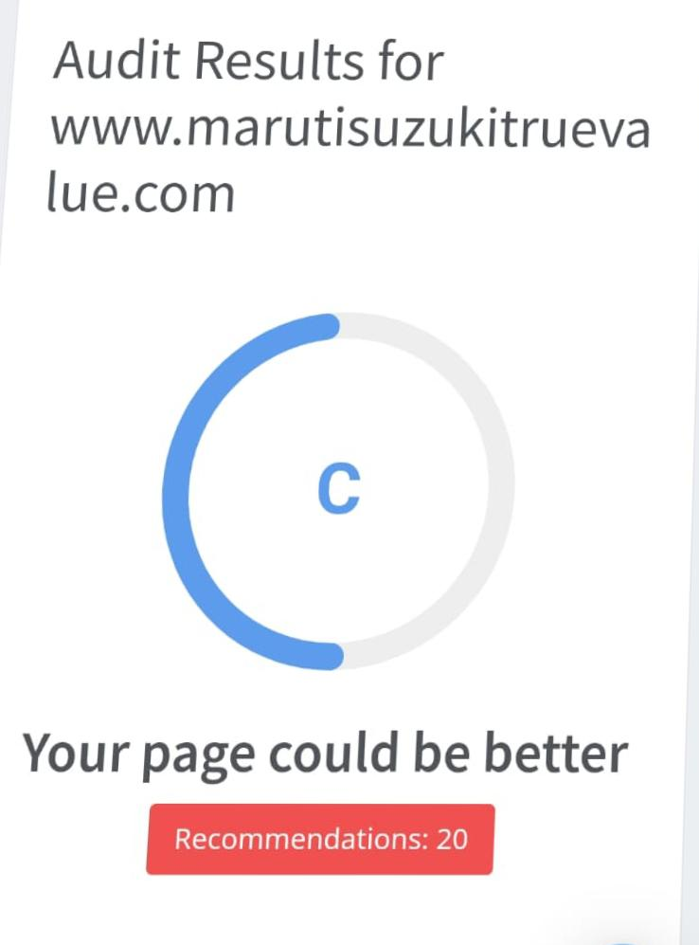

Slide 9
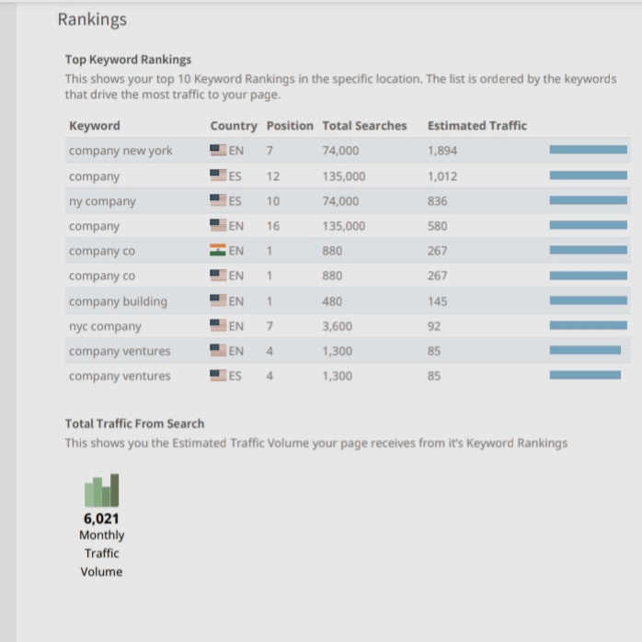
Ranking :

Slide 10
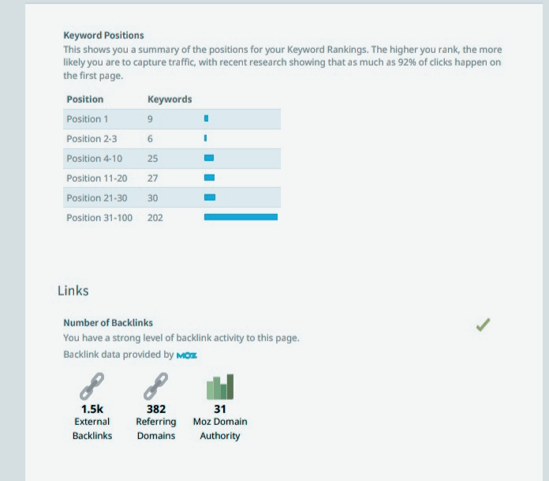
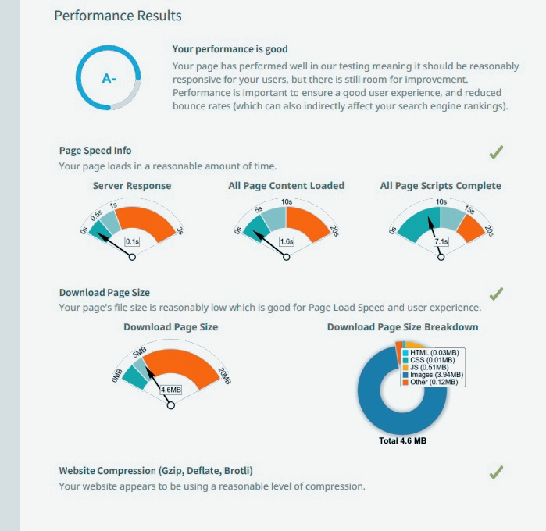

Slide 11
Part 3 : Content ideas and Marketing Strategies
Content idea generation & Strategy : The basic aim of the Marketing Strategy of Maruti Suzuki is to give you deep insights into Maruti Suzuki’s journey from a mere collaboration between Maruti Udyog (A government-owned entity) and Japan’s Suzuki Motor Corporation in the early 1980s to being at the top of the auto industry presently.
Swot Analysis :
Strengths :
* strong brand reputation and market presence in India.
* Cost – Effective manufacturing processes result in competitive pricing.
* product Quality
* Market Share
* Number of Share

Slide 12
weaknesses :
Weak interior quality
Government intervention
Penetration inability
Weak managerial & Labour Relationship
Threats :
Controversies
Fall. In market share
Costs and Expenses

Slide 13
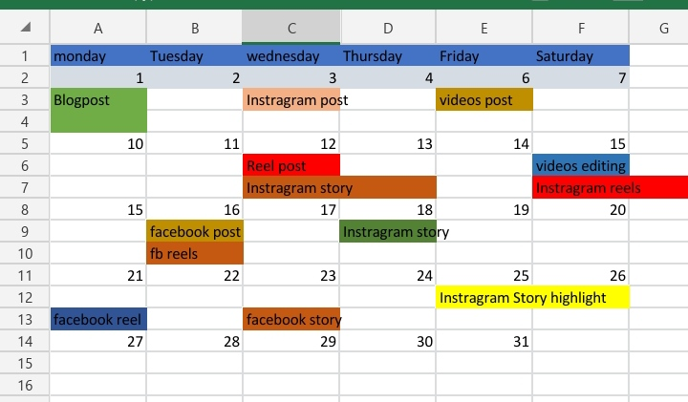
Content Calendar Of Maruti Suzuki

Slide 14
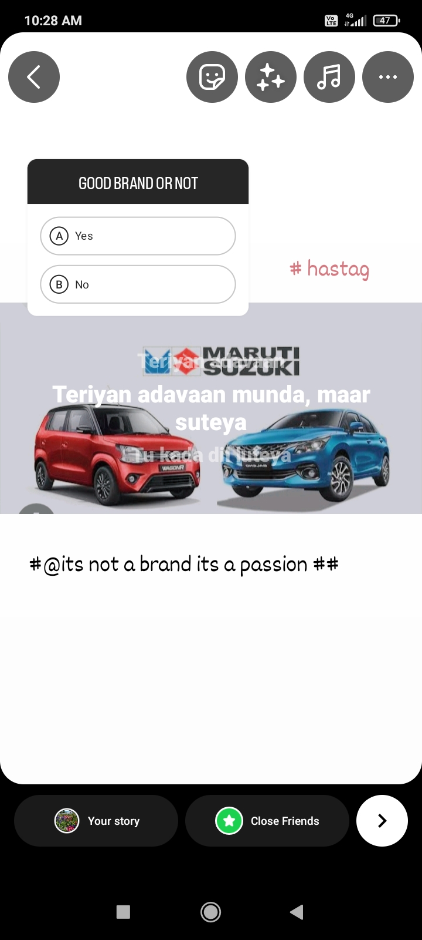
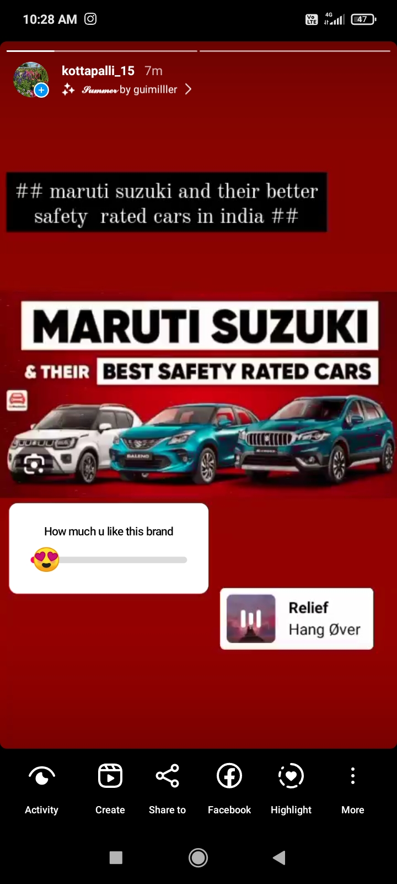
Part 4 : Content Creation and Curation
Instragram Story: Instagram story is knowing about the Maruti Suzuki and nita ambani are collaborating each other so they can tell about the business announcement.
URL ID link : https://instagram.com/stories/kottapalli_15/3212440173413685211?igshid=MTc4MmM1YmI2Ng==
https://instagram.com/stories/kottapalli_15/3212443494396563855?igshid=MTc4MmM1YmI2Ng==
Instragram Alc: https://www.instagram.com/invites/contact/?i=s3pbsfmfou8i&utm_content=sfemchx

Slide 15
DESIGNS / VIDEO EDiTiNG
Video editing : in this we use the capcut app and vpn power to use the
Attributes of cap cut and use the pictures arts app for photos editing.

Slide 16
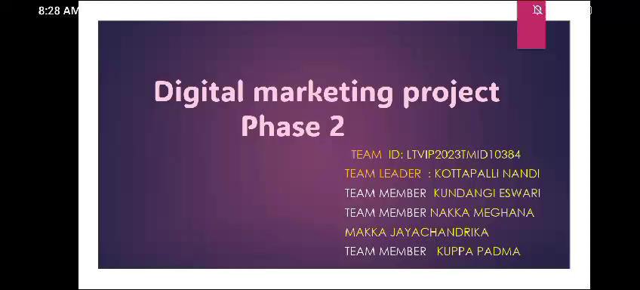
Project presentation

